Slide 1
DSA
-
Deep Learning [4]
Reinforcement Learning, Part 1

Slide 2
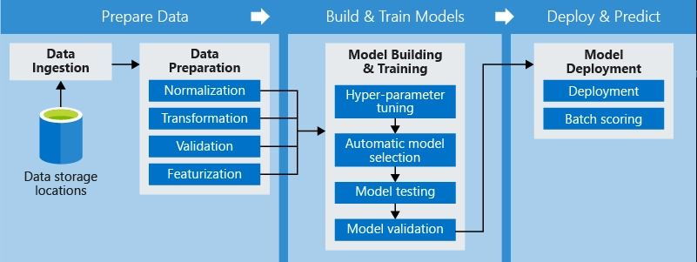
Firstly, a recap on the ML pipeline

Slide 3
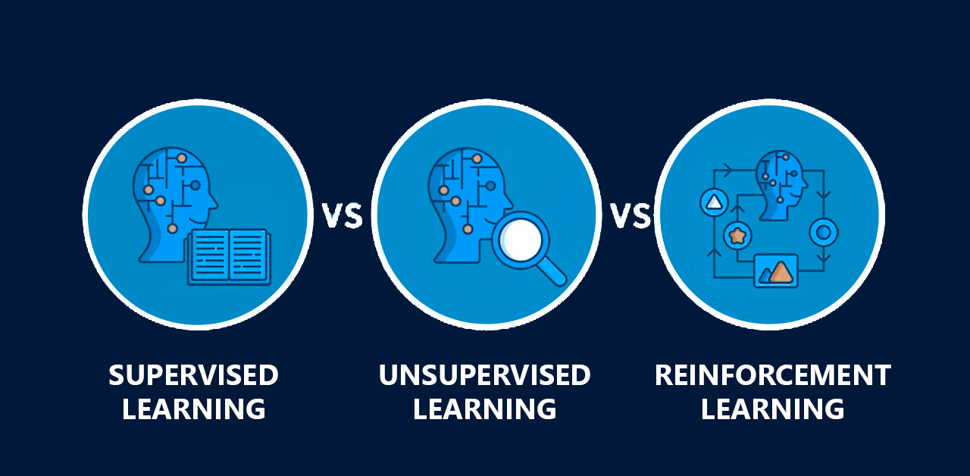
The Big 3 ML Methods

Slide 4

Goal: Train a computer to learn and get good at playing Flappy Bird

Slide 5
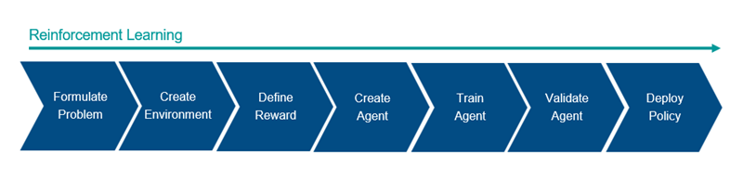
Reinforcement Learning Pipeline

Slide 6
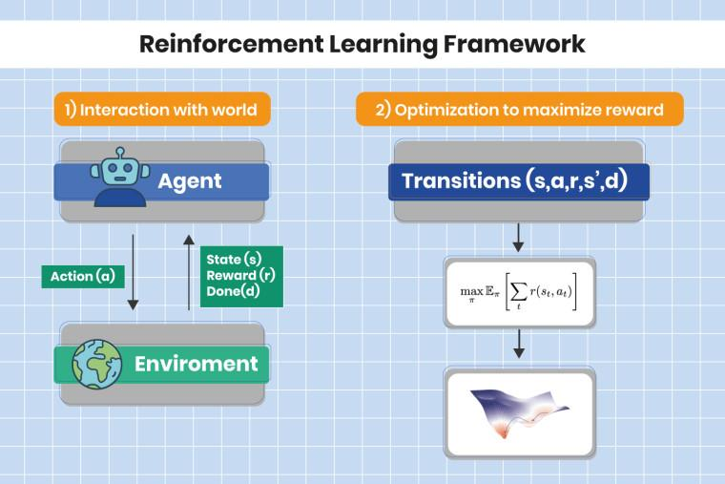
How it works

Slide 7
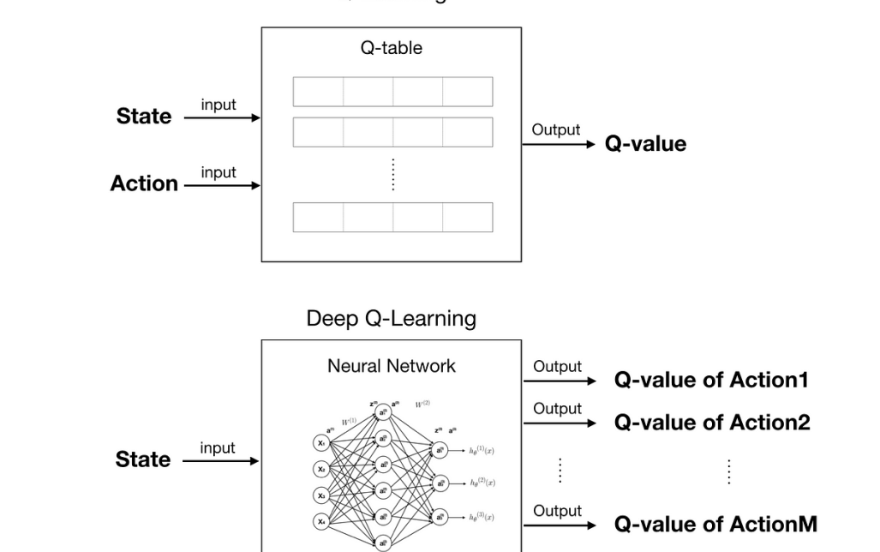
DQN Learning

Slide 8
Let’s CODE!!!

